Slide 1


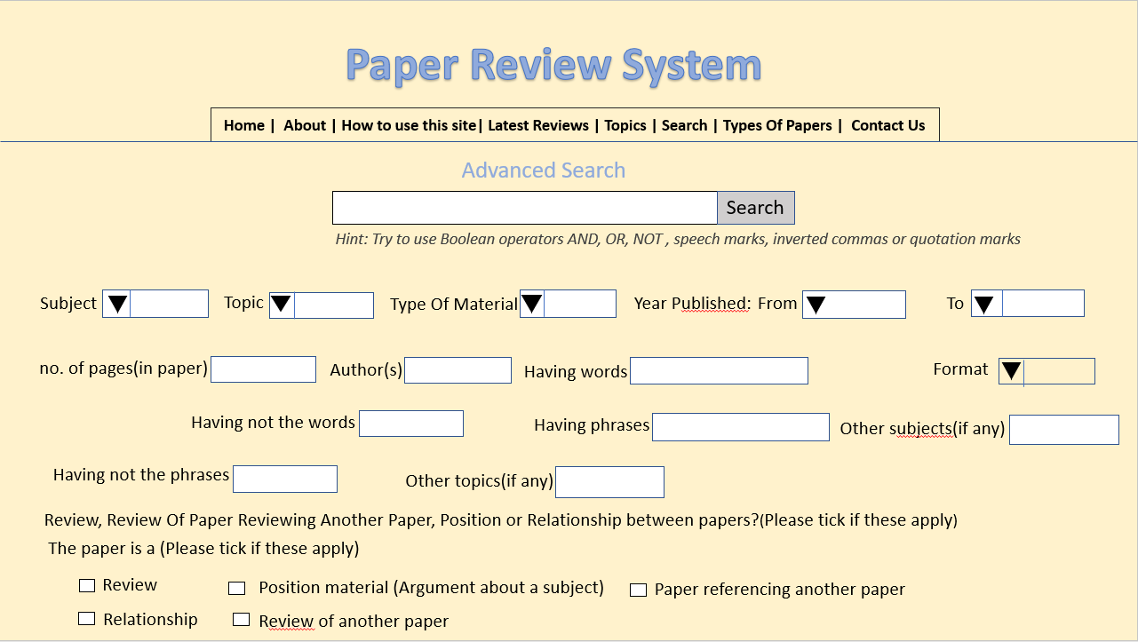
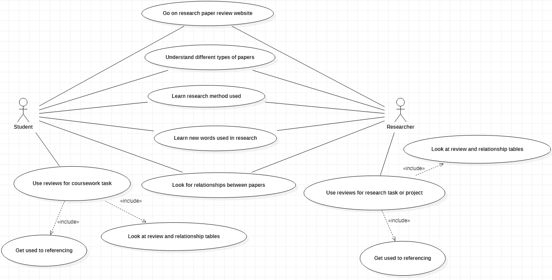
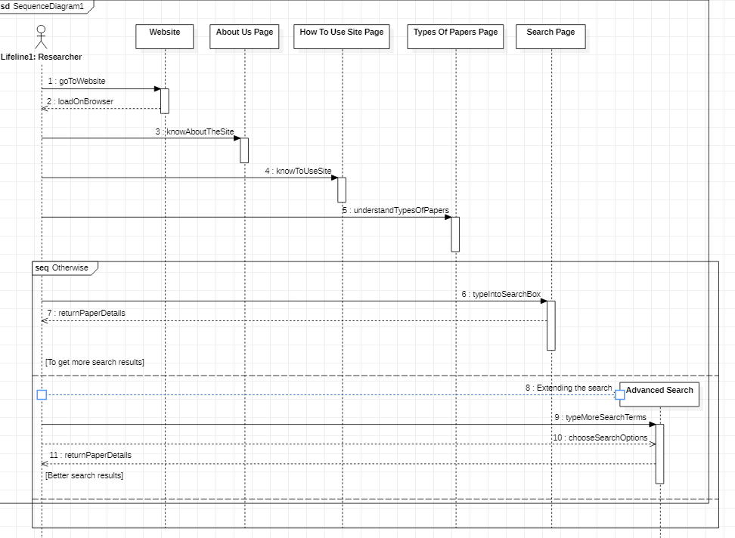
Poster Title
Author Name
Contact e-mail: firstname.lastname@uwl.ac.uk
Abstract
Methodology
Abstract:
Students and researchers are meant to read many research papers for a subject or topic they studying. They would need to read reviews of the papers they have read to know how useful, relevant and helpful they are. So far there does not seem to full clear source of information that gives reviews and full clear details of research papers. Some samples of reviews in tables that can be found on different web sites may not be enough or the reviews of the exact papers students and researchers are looking for.
Searching for a review on the internet may take time ending up with those that bog them down with too much detail or some detail that is not relevant to what they want or need to read. It is worth having relevant information organized on just one website that is clear to people. Clear for them to understand what is being said on the website. They would like to be able to find and read enough information, images, videos, graphics that is organized. Organized in a way that helps them know which research papers help them with their coursework or research they are carrying out to write an article.
Websites in universities that students find they can use with less difficulty and can achieve the purpose of using it are two points to look into. The results from a survey given to 450 undergraduates show that 403 out of them answered as preferring to use the course website for their studying.
Introduction
The subject of designing and developing a website is interesting. It is interesting to people who may have learned to develop it in ways. Ways such as writing code in the mark up language HTML to make their web pages or pages. You end up being interested by learning , even coming across books about designing and developing websites or often using websites for whatever you want or need to use them for. Also suddenly seeing layouts to design them or the code in languages such as html to make them work. Other people like a website to search for specific information they want to read through or look at. Pictures, images, videos, graphics moving images or even tables of information on a website make people enjoy using it.
We have the chance to use all this on the screen in front of us rather than having to move to different places to get this or look for different sources that have this such as books, newspapers, magazines, calculators or telephones. There is information, images, videos, pictures, diagrams , bits of text that is kept simple or in full paragraphs of detail for us to read on the screen. Simple is more interesting, useful, easier and quicker for some people. It depends what you need to use the website for whether it is to find specific information about a topic you are studying or are interested in reading. The design of a website is rather important. This is because you need to plan how each page of it will look and what it will have on each page to make user be happy with using it to find specific information.
This project has the purpose of creating a website that lets students and researchers go through specific details of the research papers they have been reading. These being the reviews of the papers to let then know how accurate and useful the papers are. This could be for students reading research to help them answer questions for a coursework or assignment. Or just researchers looking for interesting facts about a subject or topic they want to write an article on. Useful information for the work or research they are doing. Suppose we have students who like a certain topic, researchers trying to write an article on a topic they like or people who like to develop websites. Students and researchers may be interested in websites such as the browser that displays them. This brings on the reason to design and develop the website to help them stay up to date.
User-centred design
Although it is challenging the design of a library website to get to information on focuses on what is on the website pages. That is what is on them being helpful, giving clues to answers to problems which can not be found elsewhere perhaps in a short time i.e. reliable. The focus is also on what the user sees being easy for them to find what they are looking and find their way through the website. Since users being satisfied with getting to information through the library website is an issue in designing library websites a model is to be part of making and running it. This is the user-centred design model which is used to look into ways of how people can be satisfied with using the library website by its design.
Results
Having done research of the design of websites it is important first to look into the way it should be used. That includes the sequence in which the user will look for specific information they are trying to find. This depends on how the pages are laid out. The sequence diagram points out the order of this happening as part of the planning. It is a simple plan of the way users like students and researchers can end up being satisfied with the use case. The case which is read reviews of research papers on websites.
.
It seems website that have a similar purpose like those being used in universities for students to learn and study on will be used by students as long as it is planned and laid out in a way. A way that is easier for them to and to find what they are looking for. More students seem likely to agree to use a website for their course to be able to learn, complete assignments and revise for exams. Certain models that focus on the planning of websites for the user such as how it is laid out are a solution. A solution to develop and see if the website works for what it is going to be used for.
Aims and Objectives
1.2.1 Aims
- To design and develop a website that students and researchers can read through to find out how accurate the research papers they have been reading are.
- Make the website give them details of what they need to look for or read in the paper.
1.2.2 Objectives
- Research the need for students and researchers to keep a regular check of the necessary information about materials they have been reading
- Find out any reason to need to have a website that stores reviews of recently read research material together on one site
- Plan out the point of and need for having the website with use of UML diagrams
- Learn the necessary topics that are to do with designing and developing the website such as online website builder to build it
Conclusions
The developing stage includes the html code with code in other languages to make the website work in the way it has been designed. It is basically trying to match the html, css and Javascript programming code to the design of the website.
References
1. Hassan M Selim, An empirical investigation of student acceptance of course websites, Computers & Education, 2003
Found at (https://www.sciencedirect.com/science/article/pii/S0360131502001422)
2. Roslyn Raward, Academic Library Website Design Principles: Development of a Checklist, Australian Academic & Research Libraries, (2001)
Found at Academic Library Website Design Principles: Development of a Checklist: Australian Academic & Research Libraries: Vol 32, No 2 (tandfonline.com)

